Slide 1

Efficient Viewgraph Sparsification and Disambiguation Using Camera Triplets
Seyederfan Eshghollahi & Safuan Iusupov
IACV project presentation

Slide 2
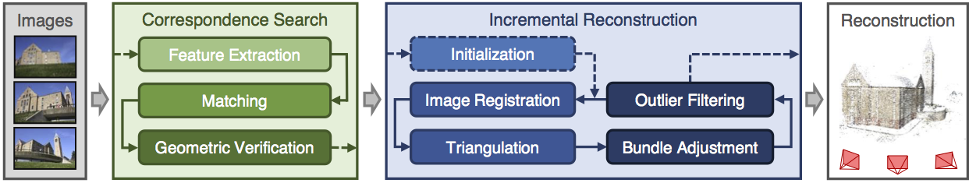
SFM pipeline
Analysed Algorithm
Notes:
Structure-from-Motion (SfM): Overview and Workflow SfM reconstructs 3D scenes from 2D images by identifying overlapping pairs and estimating camera motion. It builds a viewgraph, where:
Nodes represent cameras (or a single camera in different positions).
Edges indicate overlapping views verified via epipolar geometry and RANSAC, ensuring reliable matches by filtering outliers (leaving epipolar inliers).
SfM Workflow:
Correspondence Search:
Extract features and match them across image pairs.
Use RANSAC for geometric verification, producing a viewgraph as input.
Incremental Reconstruction:
Start with initialization, image registration, triangulation, and outlier filtering.
Perform bundle adjustment to refine 3D structure and camera motion.
Analysed algorithm operates between the steps, optimizing the viewgraph by:
Sparsifying it.
Removing ambiguous nodes to improve efficiency and accuracy in reconstruction.

Slide 3
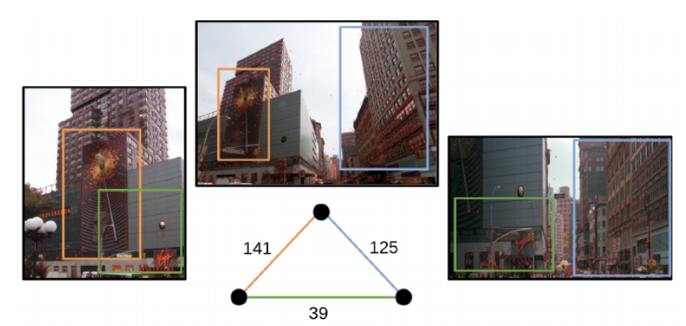
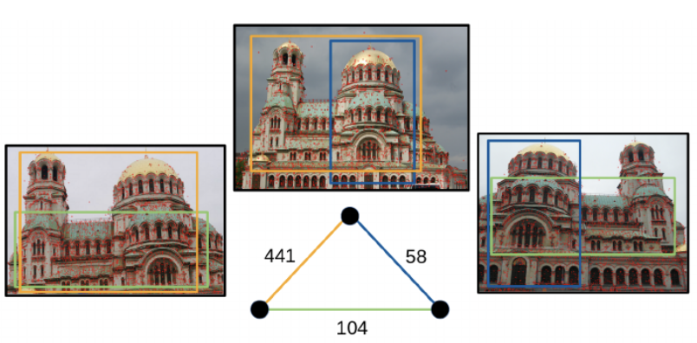
Two types of datasets
Generic dataset
Ambiguous dataset
Notes:
Generic vs. Ambiguous
Generic Datasets:
Unordered image collections with frequent redundant images and edges (capturing the same areas).
The main goal for algorithm is sparsify this view graph to speedup reconstruction time
(Green edge correspond to low number of inliers, so this edge may be removed, to sparsify dataset)
Ambiguous Datasets:
Scenes with repeated structures (e.g., building facades).
Produce false edges between cameras capturing distinct but similar areas.
The main goal for algorithm is remove false edges
(Blue and green edges correspond to the false ones, caused by the corresponding features of two different facades of the same building. The number of inliers for these edges is smaller compared to the true edge, and they can also be removed to deal with ambiguity)

Slide 4
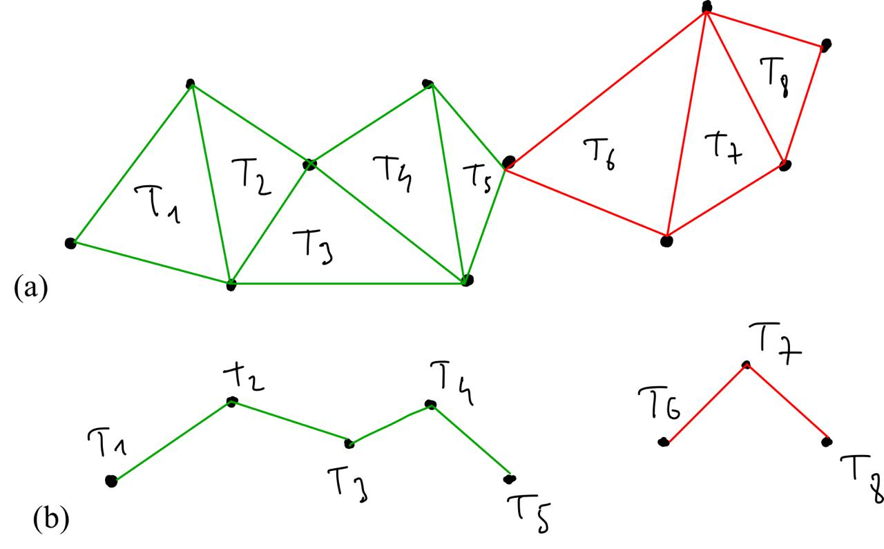
Analysed Algorithm
Construct Triplet graph Gf from source graph G
Retain edges in G participating in LCT of Gf
Find all triplets in G-LCT
For each edge in all triplets assign weight
Update edge weight as average from all triplets, containing this edge
Compute threshold
Remove all edges from G-LCT using threshold
Notes:
LCT - largest connected component
Image a:
Node - image from camera, edge - connection between images, based on epipolar inliers. (it is viewgraph)
Image b:
Node - triplet, edge - connection between triplets (if triples have common edge, they will be connected. If triplets have only common vertex - then they are joint and disconnected)
Why Use Triplets in SfM?
Triangulation Basis:
Triplets form the minimal configuration for robust 3D triangulation.
A third view adds redundancy, reducing ambiguities and improving stability compared to using only two views.
Geometric Consistency:
Ensures reconstructed points from any camera pair can be validated using the third camera.
Helps detect errors and improves the reliability of 3D reconstruction.
Computational Efficiency:
Triplets reduce computational costs by focusing on smaller subsets rather than all pairwise combinations.
Balances efficiency with reconstruction accuracy.

Slide 5
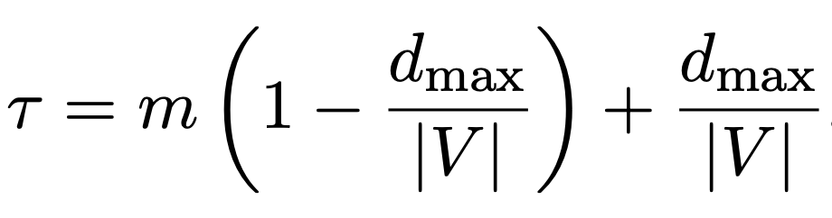
Thresholding
d-max – maximum node degree
|V| – number of nodes
m – minimum accepted score
Notes:
Interpretation:
High connectivity → Higher threshold, aggressive pruning.
Sparse graph → Lower threshold to preserve essential edges.
Scores computing:
Edges are scored based on the ratio of inliers on each edge to the maximum inliers among the triplet's edges.
Focuses on relative 3D point connectivity, not absolute inlier counts, for more robust evaluation.

Slide 6
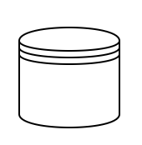
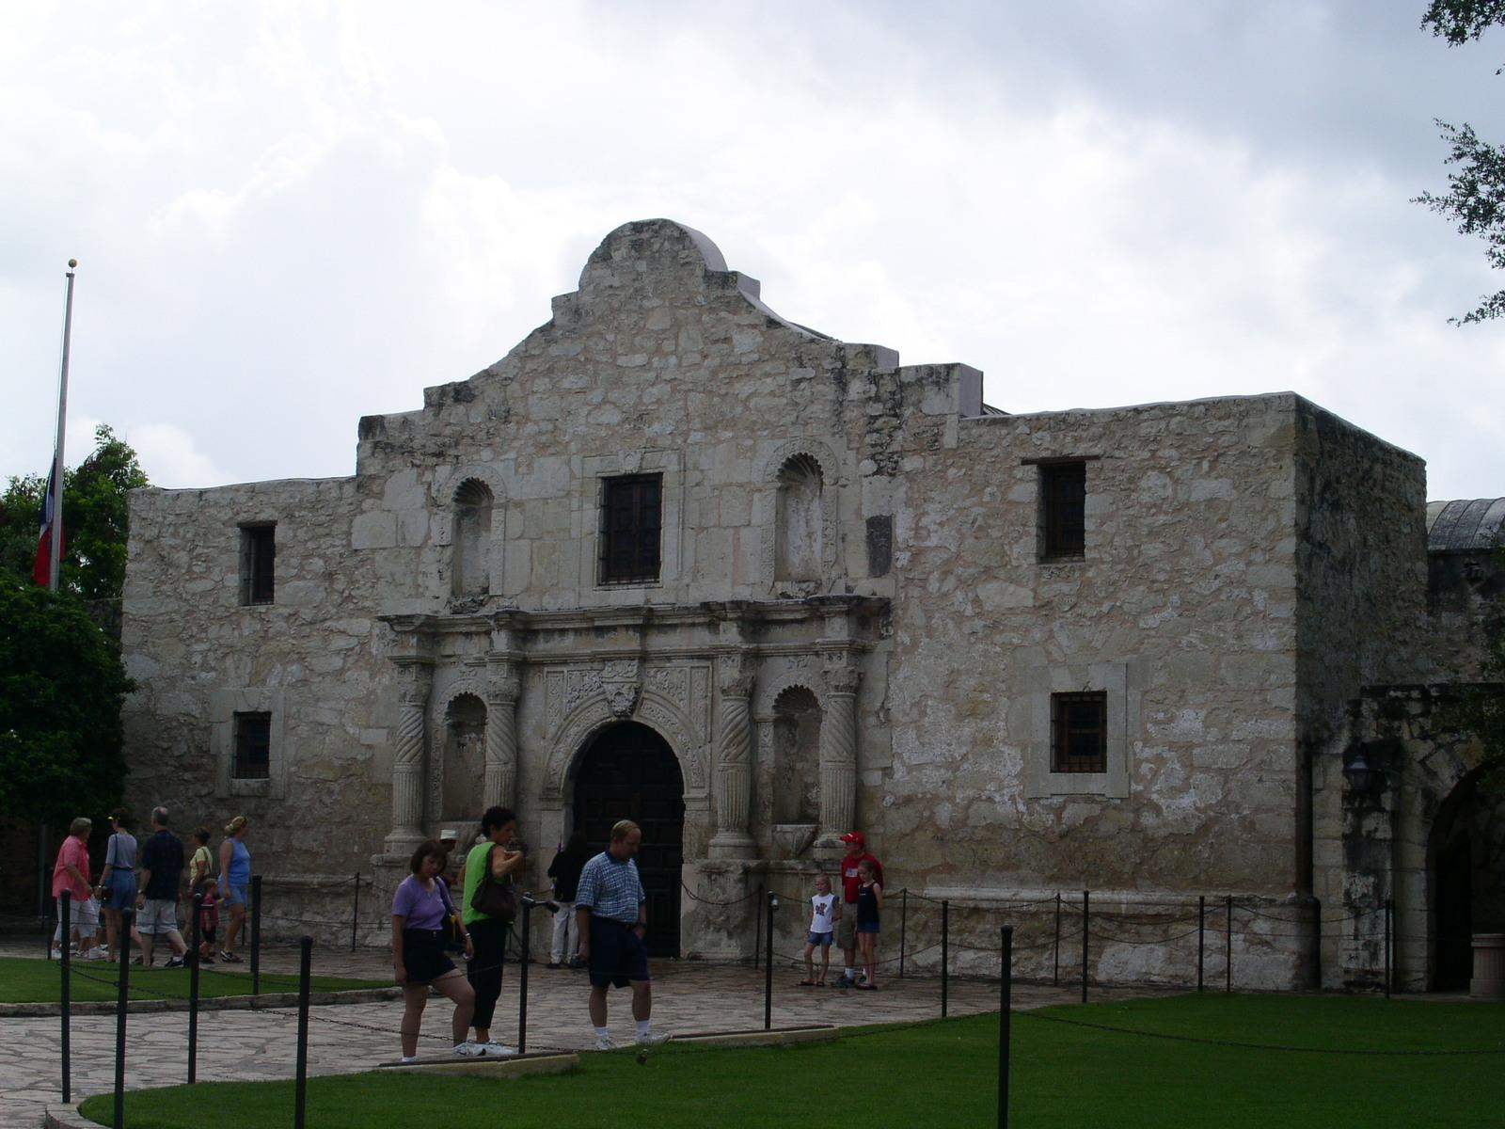
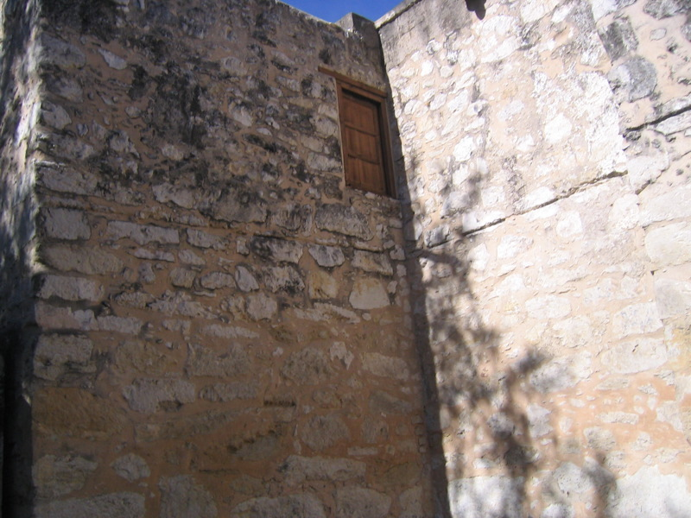
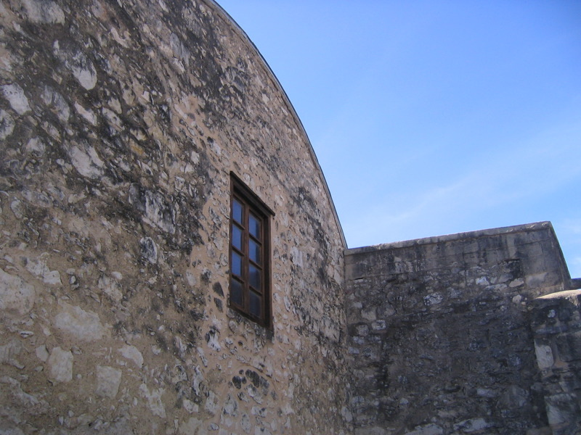


Our trials
Notes:
The authors of the referenced article conducted experiments on both general (large and medium-sized) and ambiguous (large, medium, and small-sized) datasets, leveraging extensive computational resources. In contrast, our focus was on small general datasets comprising fewer than 400 images. All our experiments were performed exclusively using a CPU, reflecting the limitations of our computational setup.

Slide 7
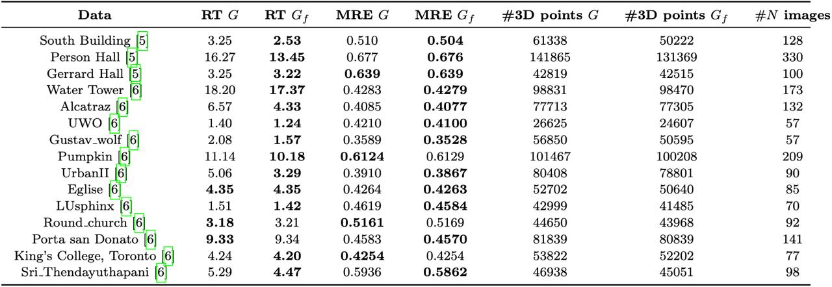
Experiment
Notes:
During experiments, like article authors, we concentrated on two main metrics Reconstruction Time (RT) and Mean Reconstruction Error (MRE) for source viewgraph and for sparsified viewgraph, received from algorithm. 5.1 Reconstruction Time (RT):
Reduced Time with Sparsification: Sparsifying the graph (G → Gf) significantly reduces reconstruction time for most datasets, e.g., Alcatrz (6.57 → 4.33) and Person Hall (16.27 → 13.45), due to fewer edges in the graph.
5.2 Mean Reconstruction Error (MRE):
Accuracy Maintained or Improved: MRE either improves or stays the same when using Gf, as seen in South Building (0.510 → 0.504) and UrbanII (0.3910 → 0.3867), suggesting that sparsification enhances consistency.
Stable Across Datasets: Most datasets show stable MRE values for both G and Gf, indicating no significant loss in reconstruction quality.
5.3 Number of 3D Points:
Slight Decrease in 3D Points: Sparsification leads to a minor reduction in 3D points, e.g., South Building (61338 → 50222) and Person Hall (141865 → 131369), due to fewer observations.
Improved Consistency: Despite fewer 3D points, the remaining points often exhibit lower MRE, reflecting higher reconstruction consistency.

Slide 8
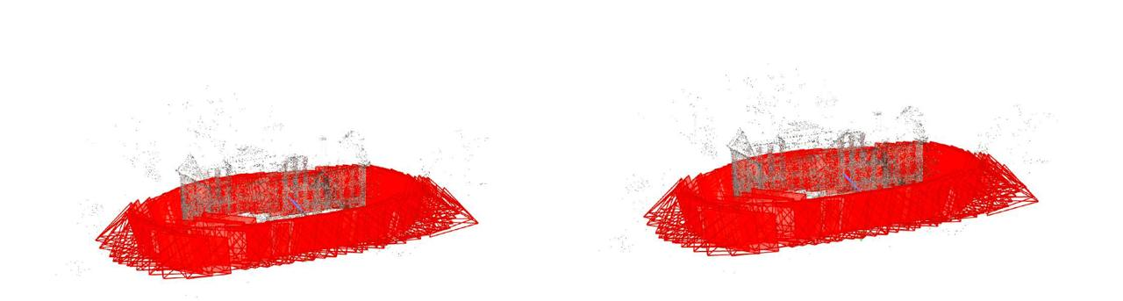
South Building
Original Graph G
RT = 3.25
MRE = 0.510
Sparsified Graph G
RT = 2.53
MRE = 0.504

Slide 9
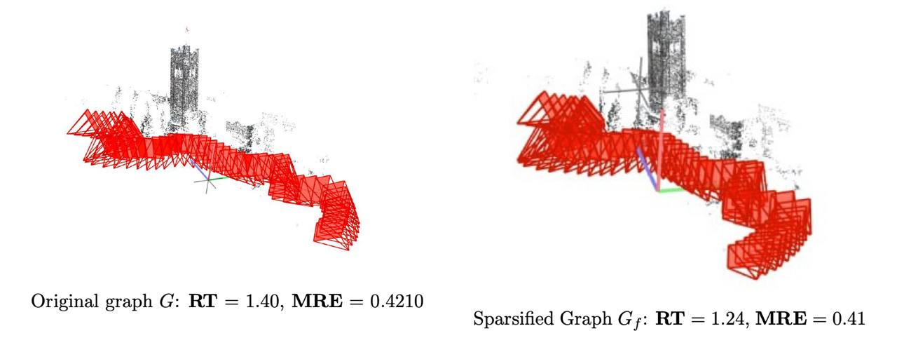
UWO
Original Graph G
RT = 1.40
MRE = 0.4210
Sparsified Graph G
RT = 1.24
MRE = 0.41

Slide 10
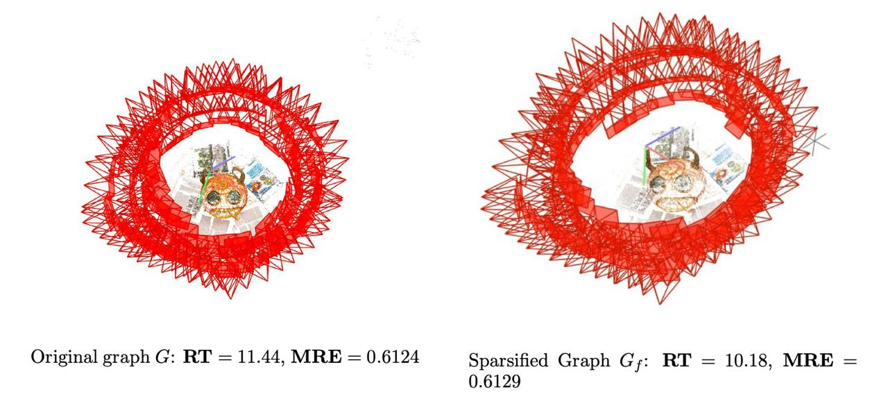
Pumkin
Original Graph G
RT = 11.44
MRE = 0.6124
Sparsified Graph G
RT = 10.18
MRE = 0.6129

Slide 11
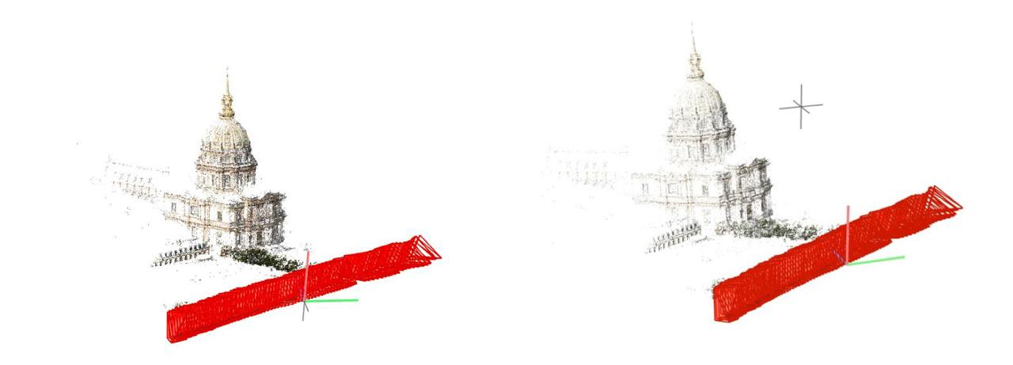
Eglise
Original Graph G
RT = 4.35
MRE = 0.4264
Sparsified Graph G
RT = 4.35
MRE = 0.4263

Slide 12
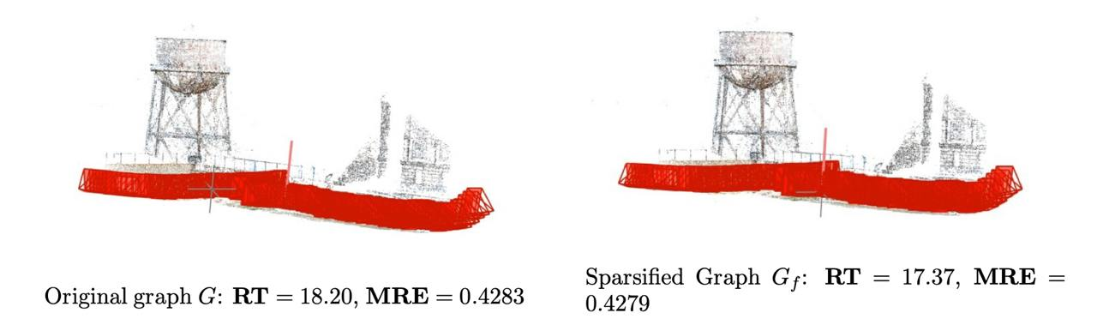
Water Tower
Original Graph G
RT = 18.20
MRE = 0.4283
Sparsified Graph G
RT = 17.37
MRE = 0.4279

Slide 13
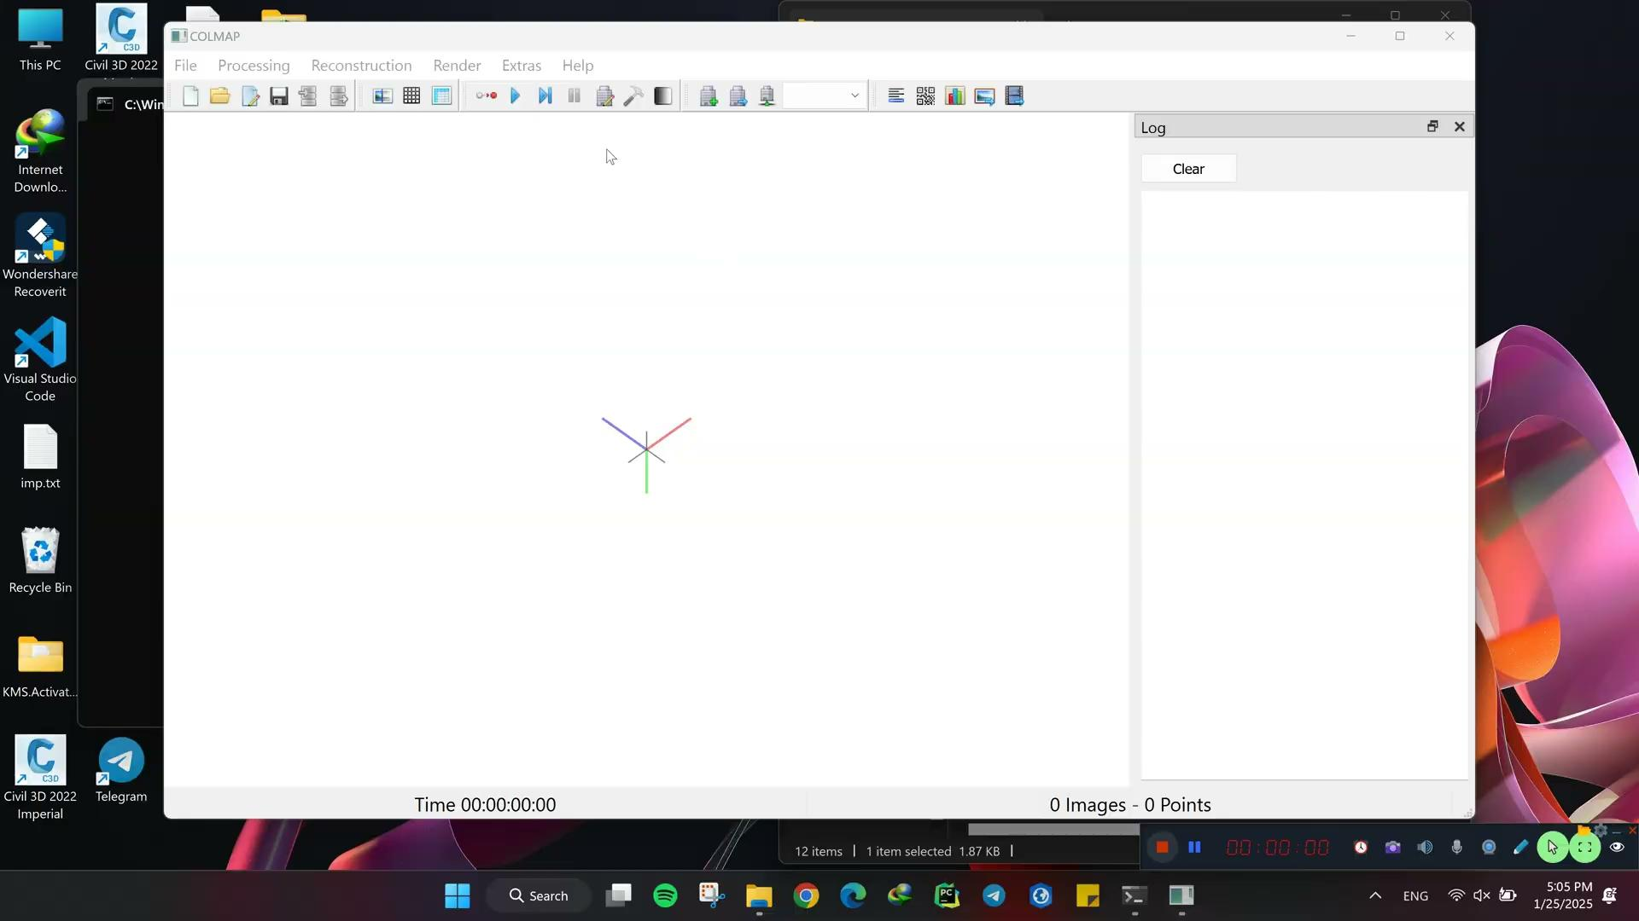
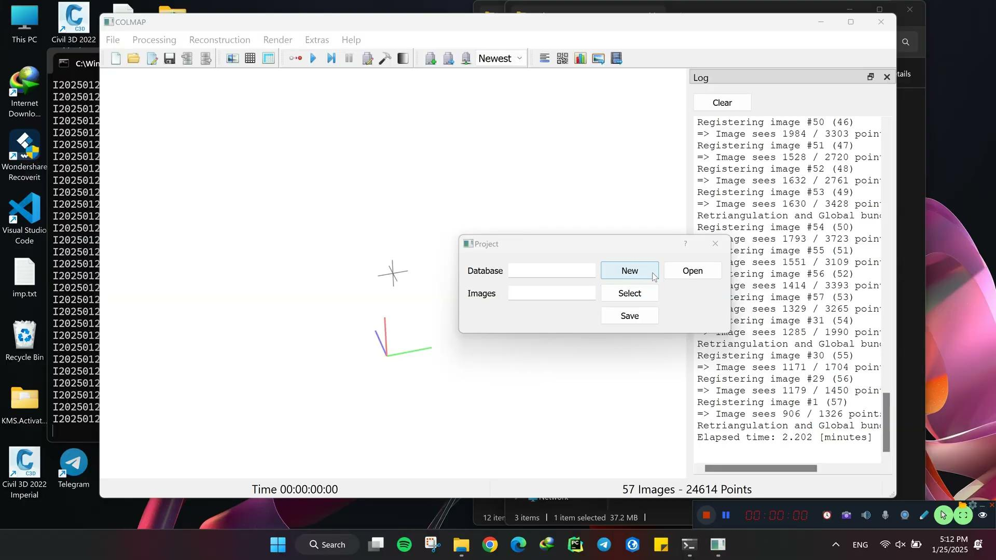
Reconstruction UWO
Original Graph G
RT = 2.31
MRE = 0.4283
Sparsified Graph G
RT = 2.08
MRE = 0.41

Slide 14
Advantages
Versatility in Dataset Types
Minimal Parameter Dependency
No Intermediate Reconstructions
Pipeline Independence
No Assumptions on Missing Correspondences
Notes:
Versatility in Dataset Types: The method effectively handles both generic and ambiguous datasets, unlike other approaches that are often specialized for one task (e.g., sparsification or disambiguation).
Minimal Parameter Dependency: Requires only a single hyperparameter, simplifying usage compared to other methods that involve multiple parameters.
No Intermediate Reconstructions: Does not rely on intermediate partial reconstructions, which are required by some competing methods.
Pipeline Independence: The method is adaptable to any reconstruction pipeline, a flexibility not always offered by alternative approaches.
No Assumptions on Missing Correspondences: Unlike other methods, it does not require predefined probability distributions for missing correspondences, making it more robust.

Slide 15
Disadvantages
Hyperparameter Optimization Required
Risk of Over-Sparsification
Notes:
Hyperparameter Optimization Required: Although only one hyperparameter is needed, finding the optimal value requires tuning, as the best results are typically within a specific range (e.g., m=0.3−0.9 m=0.3−0.9).
Risk of Over-Sparsification: Sole reliance on G-LCT scores can lead to the removal of significant edges, potentially causing the loss of crucial information, particularly in small datasets.

Slide 16
Conclusion
Effectiveness for Small Datasets:
The algorithm, originally designed for larger datasets, reduces reconstruction times effectively even with fewer than 400 images.
Demonstrates versatility in resource-constrained environments.
Efficiency-Accuracy Balance:
The algorithm maintains a strong balance between efficiency and accuracy across different dataset types (generic/ambiguous) and sizes (small/medium/large).
Reduces reconstruction time while maintaining 3D point count and improving Mean Reconstruction Error (MRE).
Notes:
Conclusion
Effectiveness for Small Datasets:
The algorithm, originally designed for larger datasets, reduces reconstruction times effectively even with fewer than 400 images.
Demonstrates versatility in resource-constrained environments.
Efficiency-Accuracy Balance:
The algorithm maintains a strong balance between efficiency and accuracy across different dataset types (generic/ambiguous) and sizes (small/medium/large).
Reduces reconstruction time while maintaining 3D point count and improving Mean Reconstruction Error (MRE).
Conclusion:
The method enhances SfM efficiency and accuracy and is suitable for datasets of all sizes and complexities.

